Slide 1
The design of bellroy.com
By Rocco

Slide 2
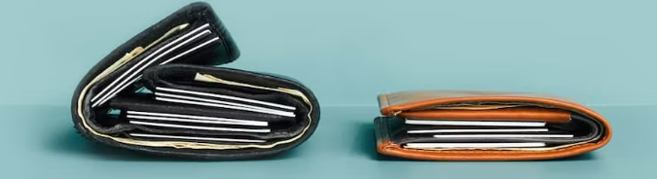
Background information
Bellroy is a company trying to slim down storage products like wallets and backpacks
As you can see above they are very effective and working to be storage efficient
They are expanding the travel storage industry as they continue to develop slim stylish ways to travel with your items

Slide 3
User Base
This is targeted at mostly young adults who travel
Students - their products are useful for daily travel and storage in school
Business travelers - they sell many different products design for work and things like laptops and folders of papers
Overall pretty much anybody who travels outside of their house can benefit from their products

Slide 4
Accessibility
Pros
Has a dedicated support email
A help tab\
Detailed description of delivery, returns, warranty, gift cards, and legal support
Cons
Only available in one language(english)
No built in screen reader
No color blind support

Slide 5
User Flow

Slide 6
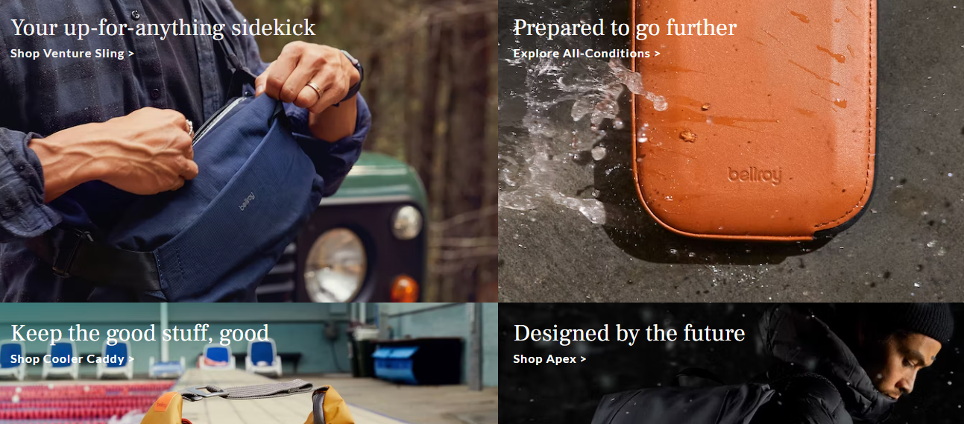
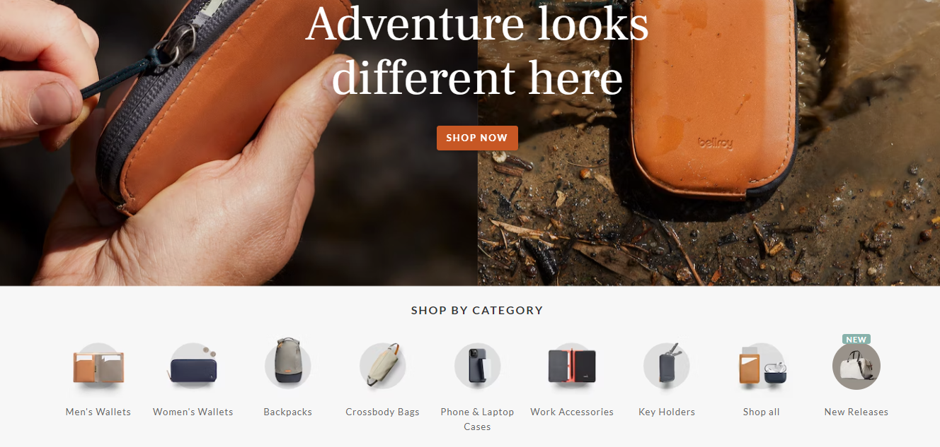
Homepage Design
When initially clicking on the website it brings you to a home page that displays most of the products
It provides an option to shop in the different categories
There are different pictures of their products as they describe why their product is better

Slide 7
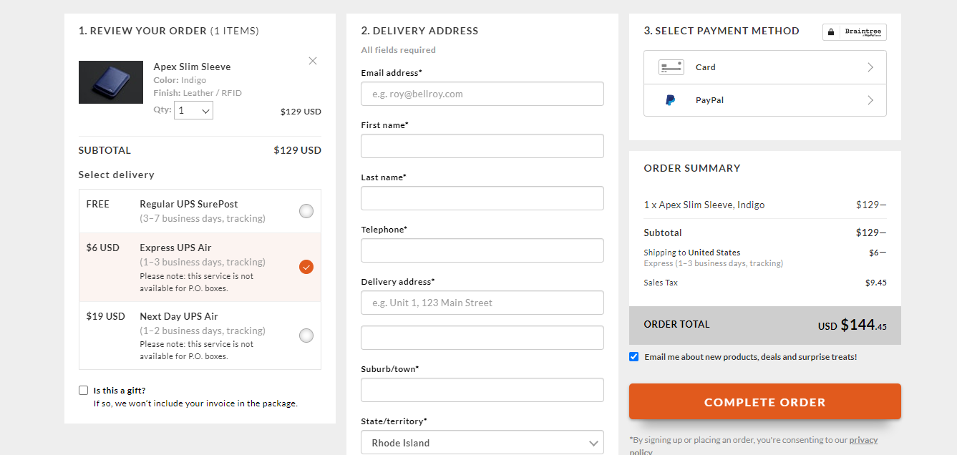
Payment experience
It is just a basic experience where the user can put in their info and have it shipped to them
Has different shipping options with different times and prices
Allows for card or paypal

Slide 8
Key Takeaways
Provide pictures of our product
Provide reasons why they should use our product
Easy simple to use payment process
Minimalistic design

Slide 9
Work Cited
https://bellroy.com/

